Slide 1
Aurum Mining Corporation (AMC) Empowering the Health & Safety organization
Trilytics’23 Conclave Case Study
Team : LeZit JanBi
Srijan Rit
Anirban Dey
Bidit Sadhukhan

Slide 2
Executive Summary
Everything in <blue font> is what we want you to fill
Initiative Goal: <State business’ desired outcomes>
WWT recommends <summarize the next steps from the analytical findings you produced> to solve for Aurum’s data inconsistency issues:
Preliminary analysis indicates that <state 2-4 biggest findings>
<In 2-3 sentences, mention the most important details about the approach you used>
WWT proposes that the steps are:
<What would you do next if you had to implement this for a client?>
<>
<>
Sample Structure
You have one page to summarize the intended business objectives, model approach, model outcome and business value to an audience that may or may not be technically inclined
This page should act as a substitute for all the slides following it; it needn’t have all the details, but there shouldn’t be a key takeaway missing from it
Remember anybody could be reading this summary; it may be the chief data scientist from Aurum who’s been working with you daily on the project, or it could be the CEO who’s hearing about this for the first time
Pro tips

Slide 3
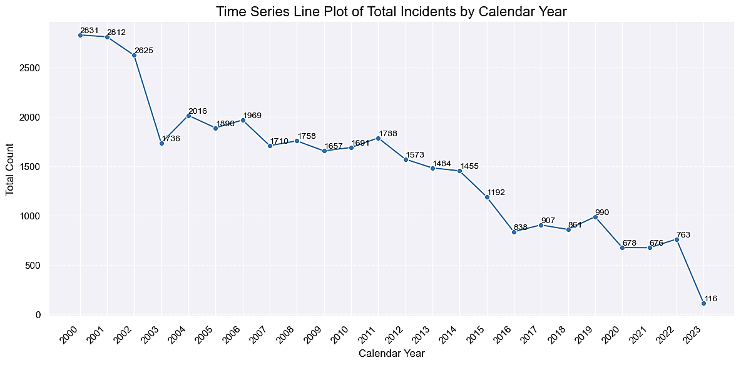
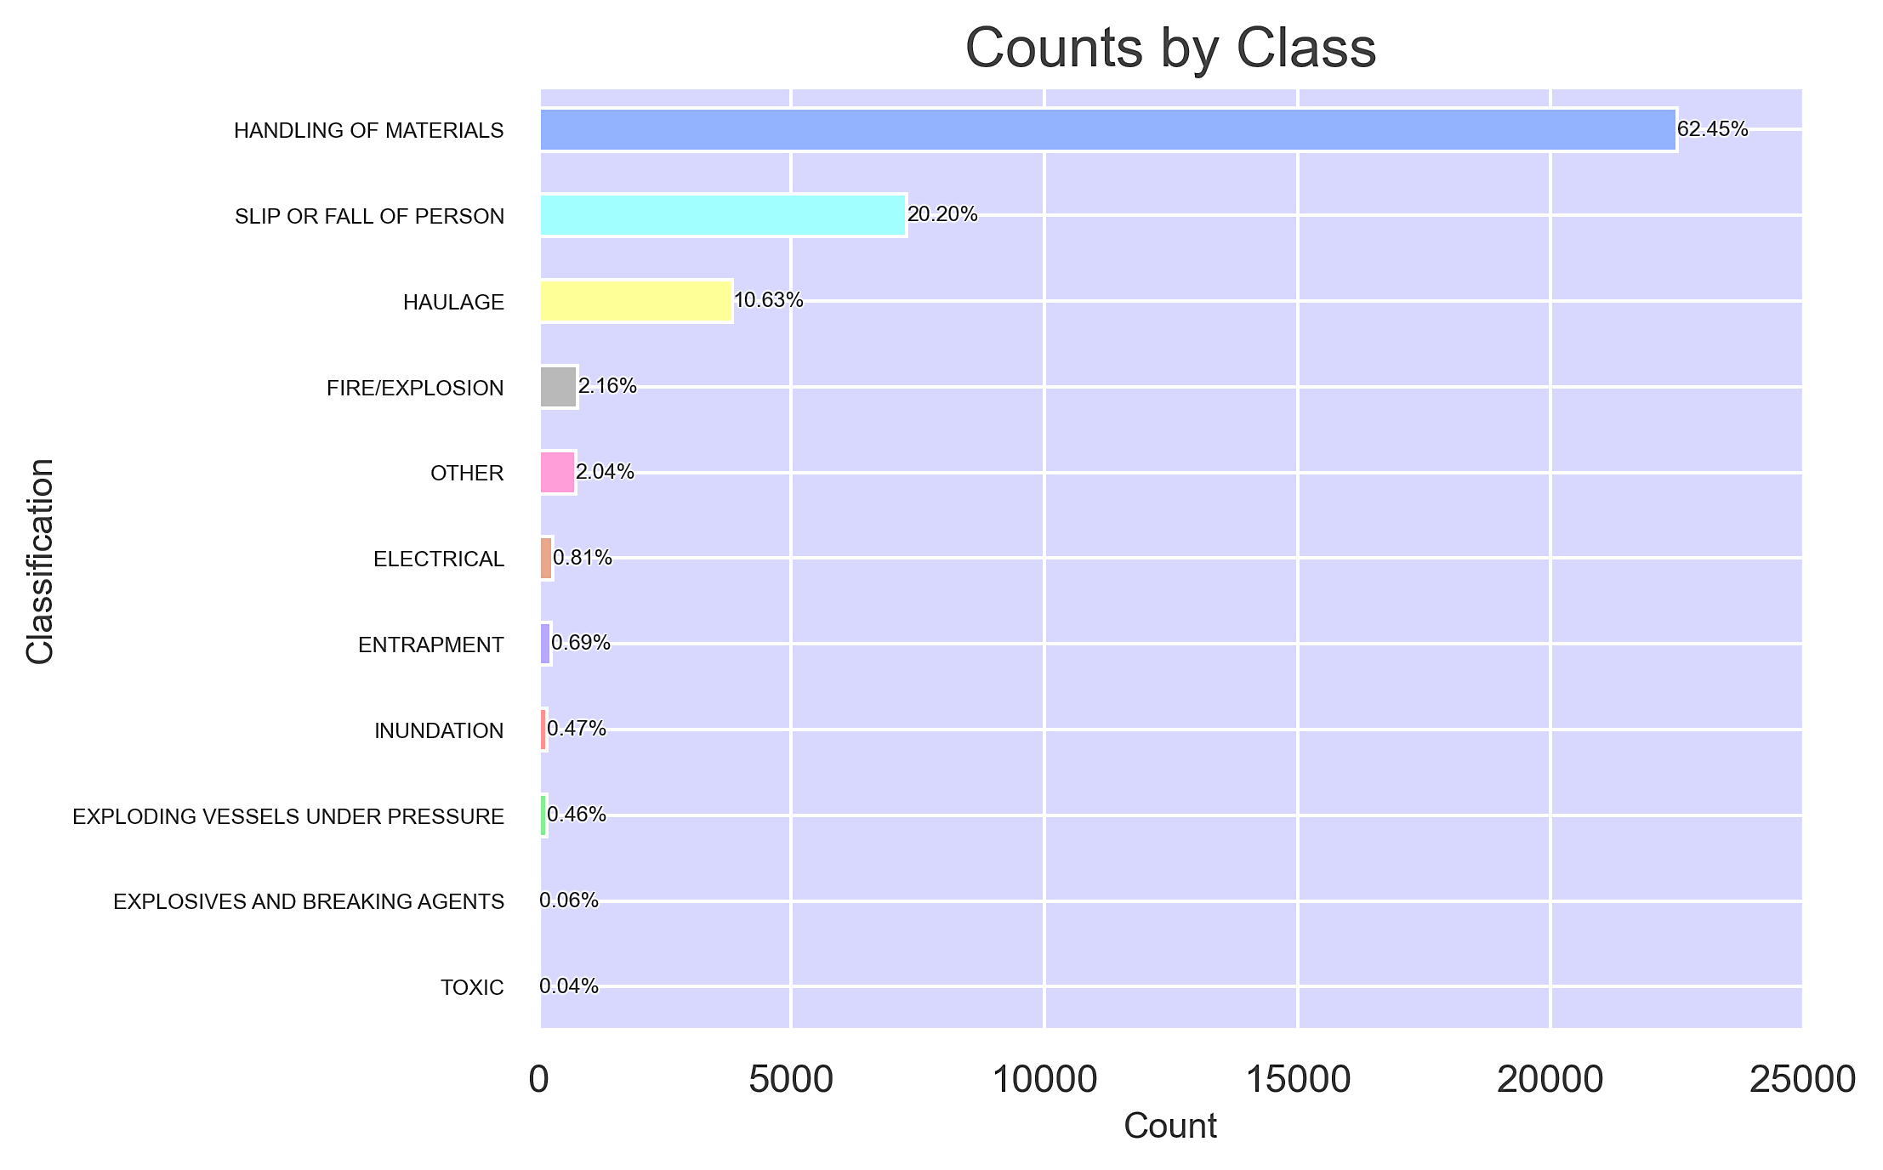
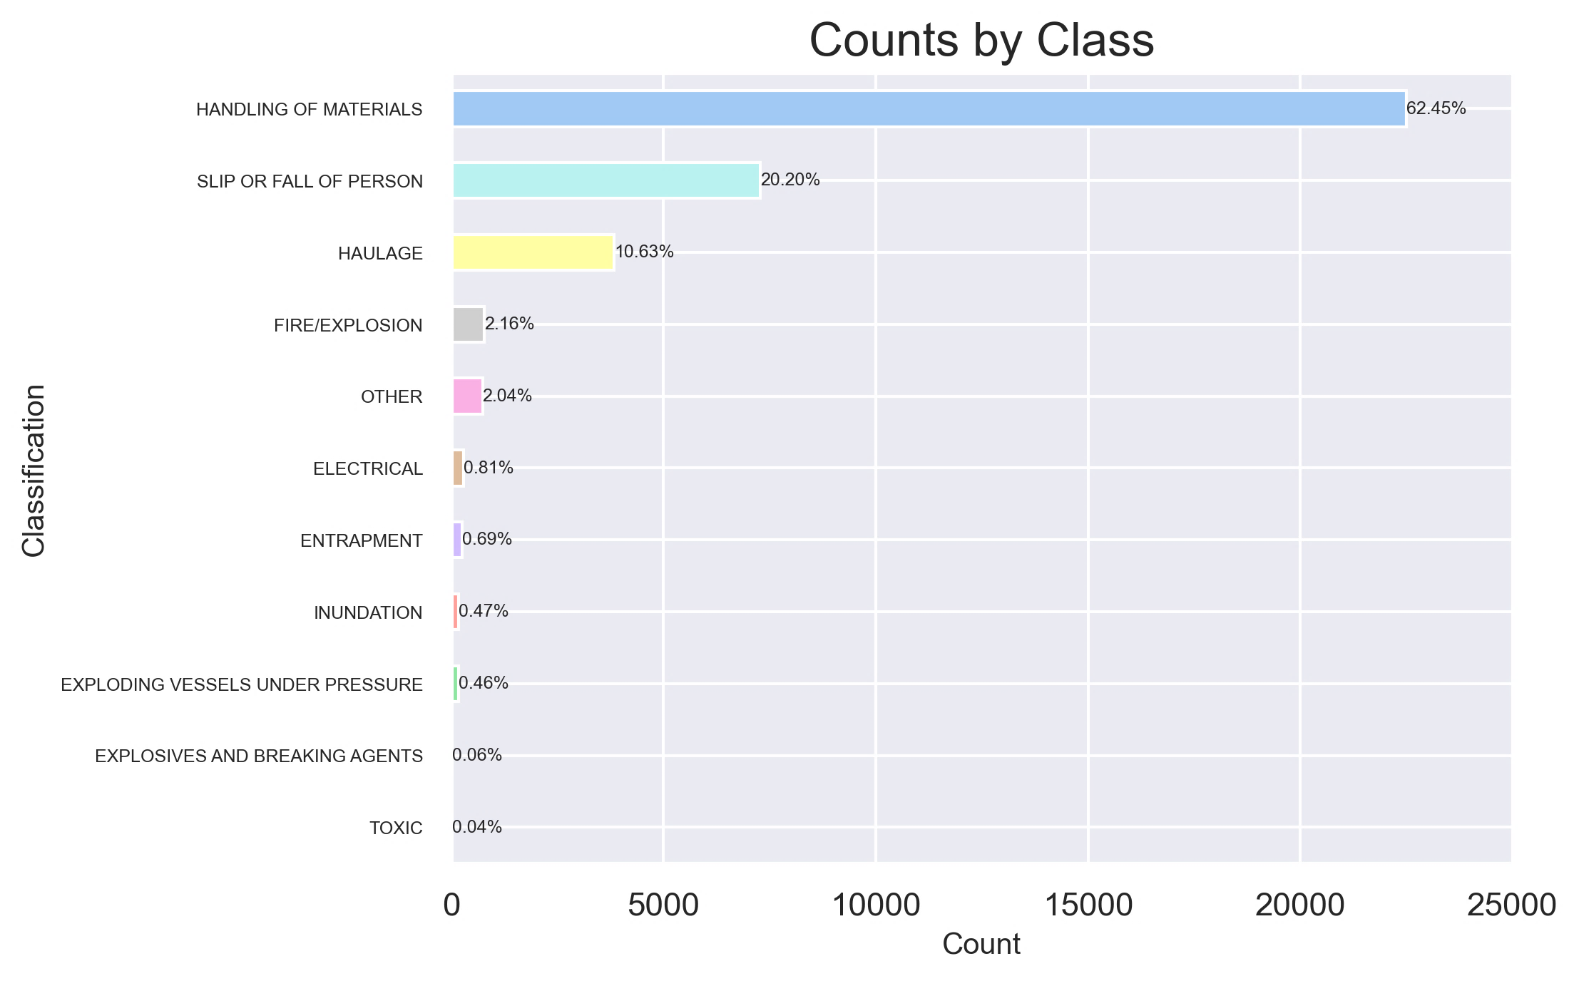
Introduction
Introduction
Mining is a dangerous industry. Accurately classifying incidents is crucial.
Manually analyzing incident descriptions is time-consuming and prone to subjective interpretations.
By leveraging data and machine learning techniques, we can:
Streamline incident classification.
Provide actionable insights to the leadership to make informed decisions.
Establish a standardized framework for evaluating health and safety across different functions within the organization.

Slide 4
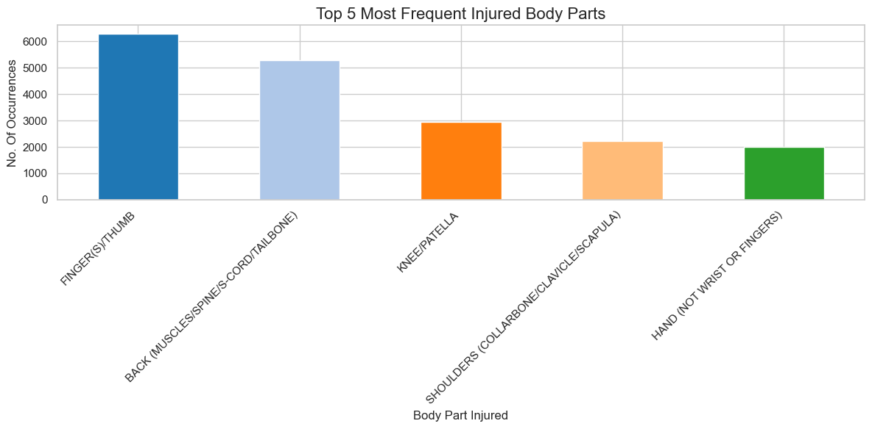
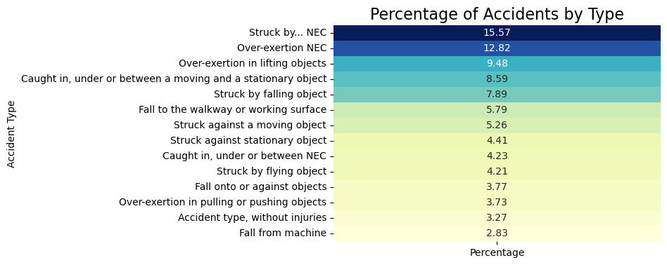
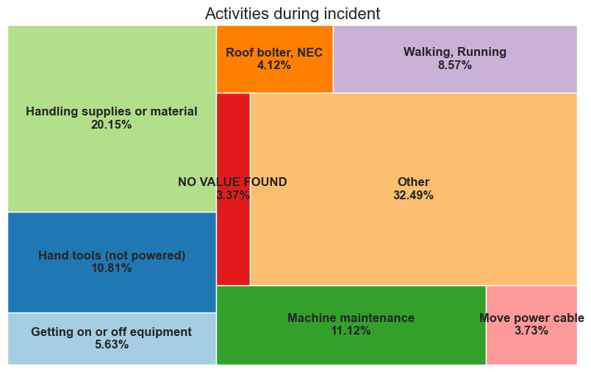
Unraveling Critical Discoveries from EDA
Empowering Safety:
The heatmap illustrates important accident types and their respective percentages, used for categorization.
The bar diagram reveals the most injured body parts during a mining accident, with Fingers (thumbs) and Back region being the most affected.
The mosaic plot illustrates activities and their respective percentages of accidental cases.

Slide 5
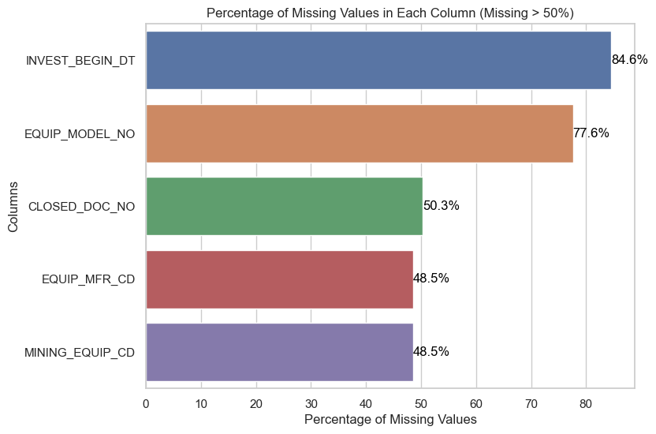
From Raw Data to Actionable Insights: Methodology for Data-Driven Analysis
Data Exploration
Visual Inspection of rows and columns
Data Processing
Dropping columns with more than 48% NA values
NA value imputation with median for numeric and mode for object type
Feature Engineering
Encoding of the categorical columns
Model Fitting
Model Accuracy
Data summarization for finding anomalies
Tokenization of the Narrative column.
Finding the most important features
Fitting the most appropriate model for classification.
Random Forest Model
Splitting the data into test, train in ratio of 80:20
Confusion Matrix and ROC curve for measuring the model performance on the unknown data

Slide 7
Outcome and Methodology Use more than 1 slide if you need
Everything in <blue font> is what we want you to fill
<Provide a journey from data exploration, model selection, feature importance and insights>
< Also use the chance to appropriately* describe the data flow (joins), architecture, model complexity, and more…>
* Appropriate for an audience that is not necessarily technically minded, but also doesn’t just want fluff

Slide 8
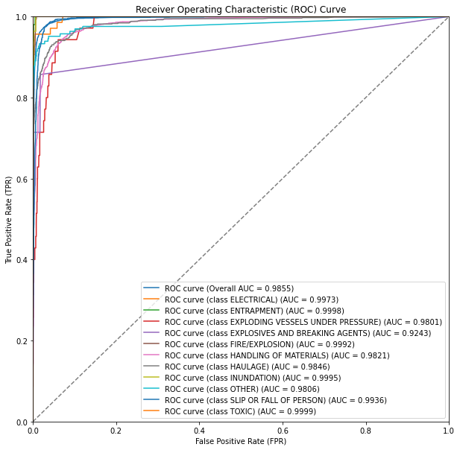
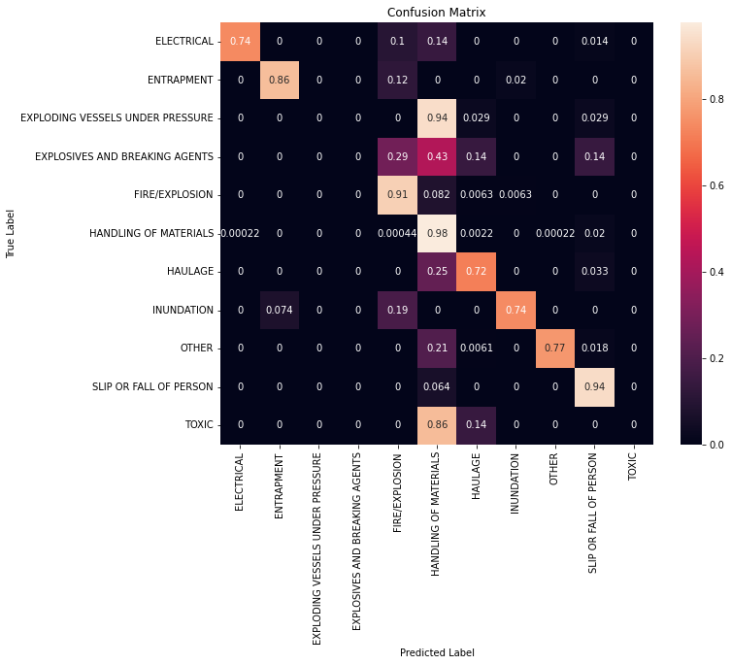
Model validation
1
2
The model achieved an impressive 92.46% accuracy despite the high class imbalance.
However, misclassifications were observed, particularly in the 'Handling of Materials' category due to the dominant representation of that class in the data.
The ROC curve showcases strong performance with an overall AUC of 0.9855.

Slide 9
Business Value and Integration
Real world implication and next steps
Some guidelines, feel free to be creative with other ideas:
What is the overall value of this solution?
Is there a way to visualize the current state vs ideal?
How do you make sure this is easy to use by Aurum’s Health & Safety data management team?

Slide 10
Appendix: Key analyses
Any other key learnings you’d like to share with the audience, or on which you may expect questions, but may not be absolutely necessary to make the main points in the prior pages

Slide 11
Pro Tips!
Executive Summary
Imagine this is the only slide you can present as part of the final project readout:
Does it capture the key points you wanted to highlight as part of the broader presentation?
Is it easy to ready (for different kinds of audiences) and has relevant metrics?
Model Methodology
Is it easy to understand both for the CEO (with a non-technical background) and the Chief Data Scientist?
Does it highlight the broad steps you followed while designing, developing and implementing the solution?
Do you need a separate slide for additional technical details?
Model Validation
How can you convey that the model you have is really a good model?
Did you follow all relevant data validation principles while assessing the model? (Train & test data sets, making sure the model doesn’t overfit…)
Are the metrices you showcase the best one’s for this specific problem? Why or Why not?
Did you use the right visuals? (Too many numbers can get overwhelming if not presented using the right visuals)
General
Some questions to ask yourself while creating any slide:
Does this slide have a compelling title which will keep me interested to look at the details? What is the key takeaway?
Can I convey the same information with less text?
How much information is too much information?
Can I make the information showcased more actionable for stakeholders?

